Slide 1
Power Consumption of Tetouan City
Martin Copello, Kartik Garg
Maya Zhao, David Wen
Source: https://github.com/martincopello/power_consumption_time_series

Slide 2
Table of Contents
01
02
Data
Problem Statement
03
04
Exploratory Data Analysis
Forecasting Models
05
06
Potential Improvements
Model Evaluation

Slide 3
01
Problem Statement

Slide 4


Data Problem
Proactive preventive maintenance schedules
Grid operations to lessen load
Prediction of equipment misoperations
Accurately forecasting load on the electric grid can have a massive impact on electric reliability, especially as we move towards electrification. Some benefits include:

Slide 5

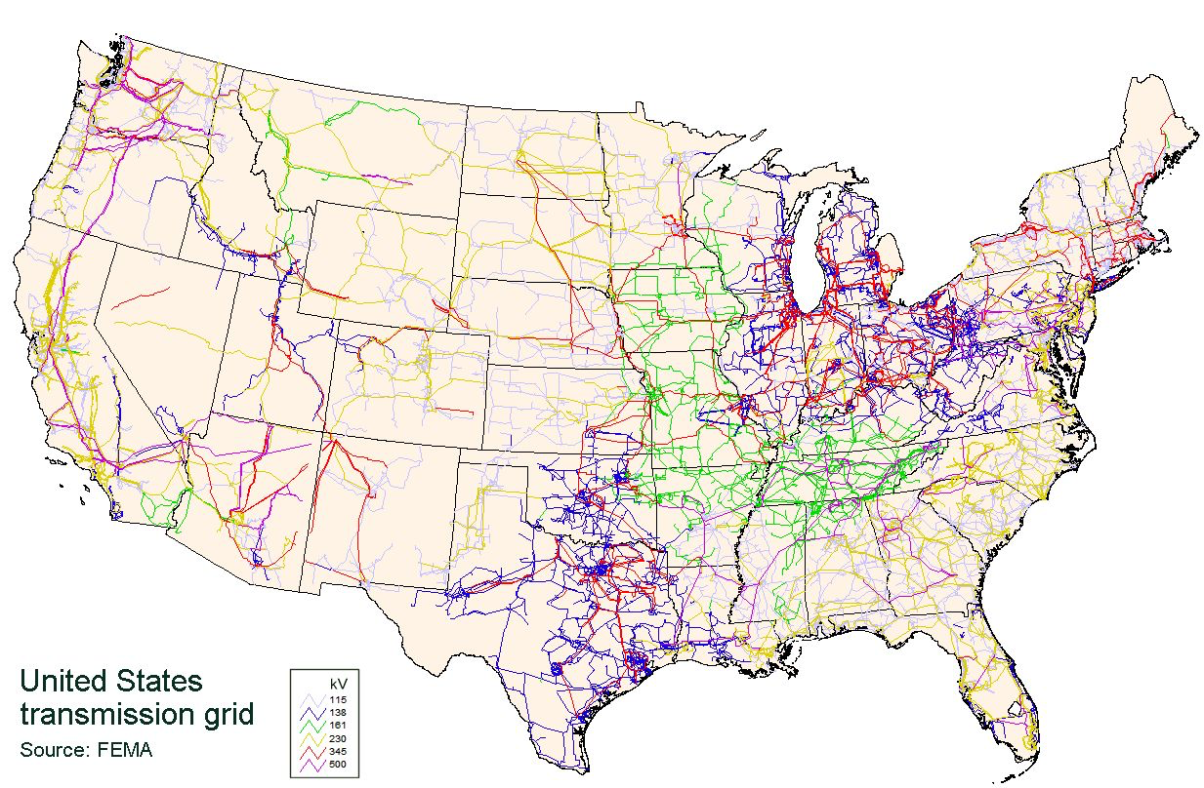
The Electric Grid
Storage of electricity
Adjust generation to forecasted usage of electricity
Interconnected networks
Reduce carbon emissions/footprint
Notes:
Electricity cannot be stored in an affordable fashion.
Taking regulatory requirements into consideration, a generator can maximize their revenues by adjusting generation to forecasted load
Interconnected networks means each network’s performance has an impact on the next, but can also be isolated as needed
Forecasting load can help reduce carbon emissions from “dirty” energy sources by cutting down on energy wastage

Slide 6
02
Data

Slide 7
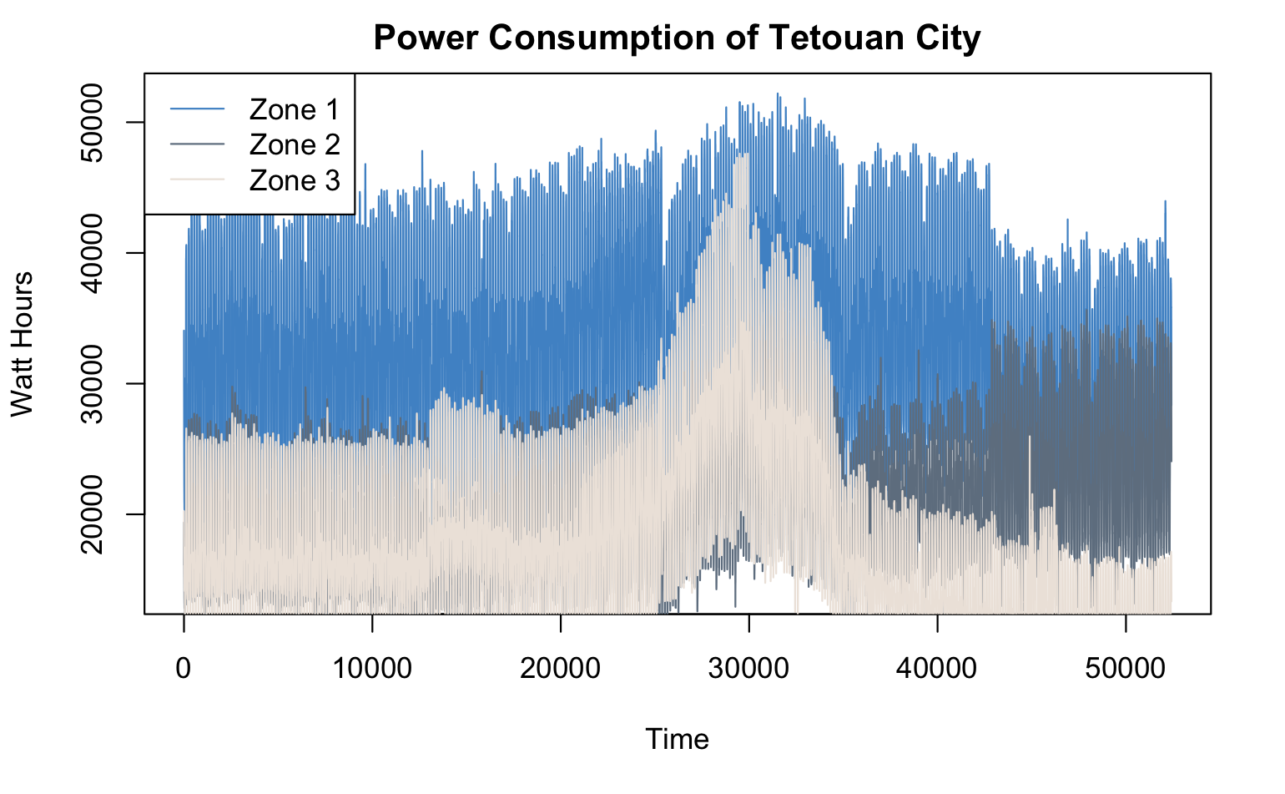
Check the data
Power consumption of Tetouan City, Morocco
UCI Machine Learning Repository
Power consumption of distribution networks of Tetouan city in north Morocco
52416 obs. of 9 variables
(no missing values)
Frequency: 10 mins
01/01/2017 00:00 - 12/30/2017 23:50
Focus: Zone 1 (blue line)
Source: https://archive.ics.uci.edu/ml/datasets/Power+consumption+of+Tetouan+city#

Slide 8
03
Exploratory Data Analysis

Slide 9
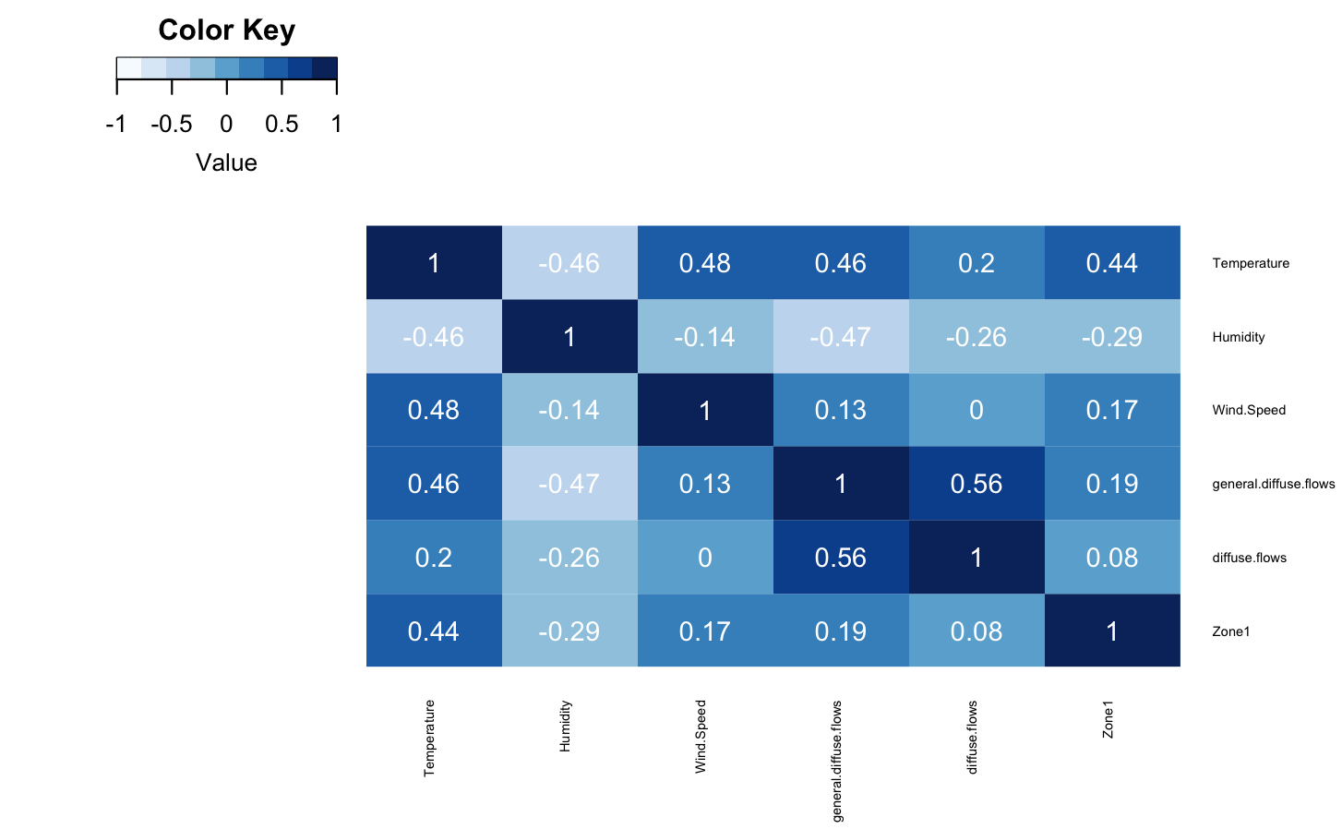

Data Dictionary
Temperature
Weather Temperature of Tetouan city.
Humidity
Weather Humidity of Tetouan city.
Wind Speed
Wind Speed of Tetouan city.
General diffuse flows
diffuse flows
Zone 1
power consumption of zone 1 of Tetouan city
Exploratory data analysis

Slide 10
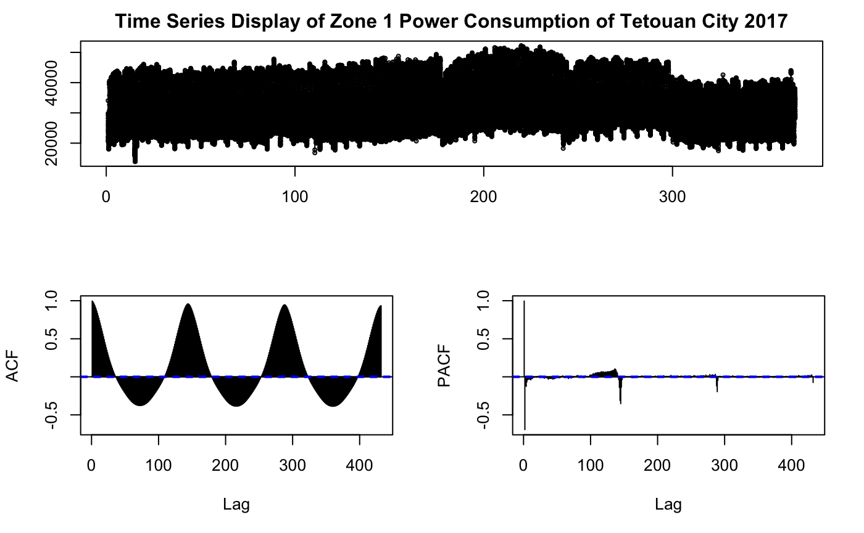
Zone 1 Power Consumption Overview
Up & down patterns
Seasonality
Slow decay in ACF shows non-stationarity

Slide 11
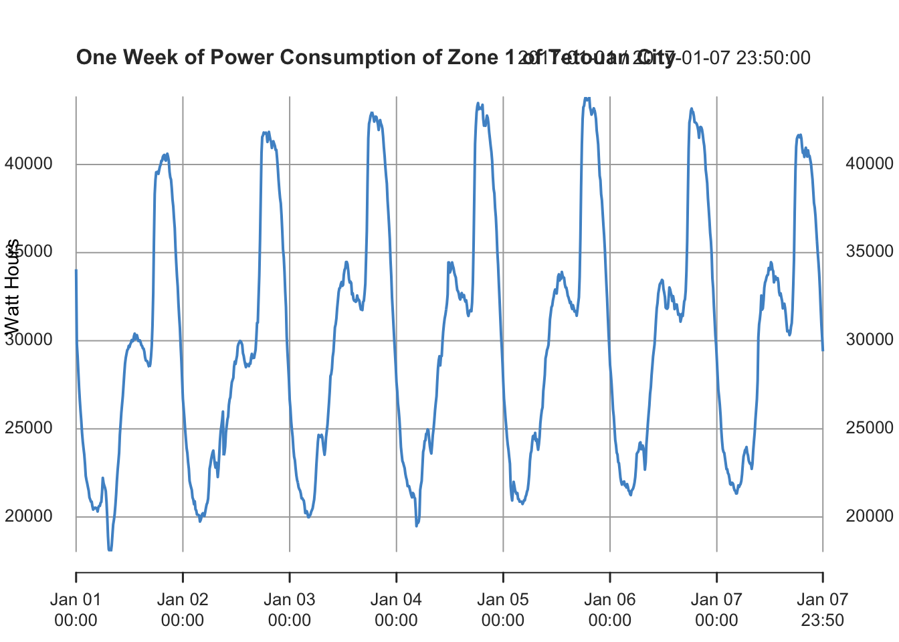
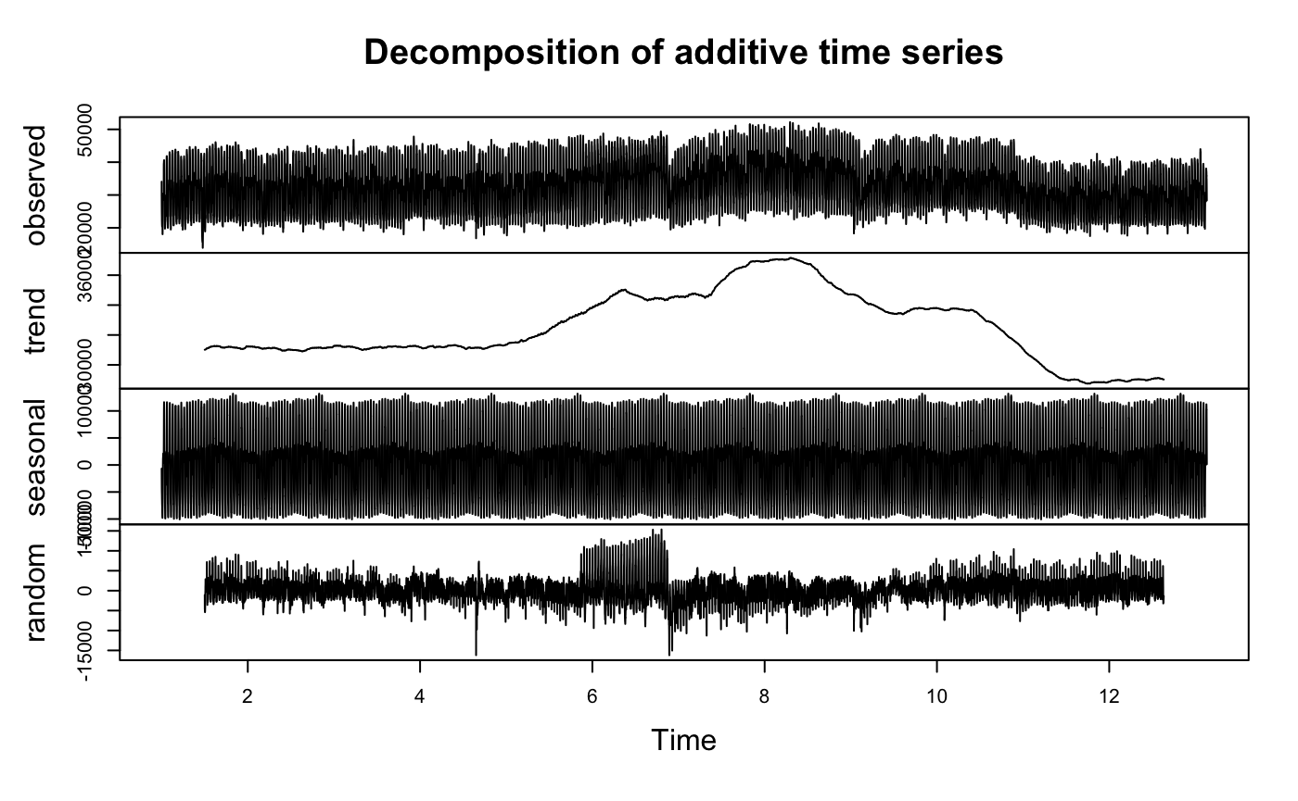
Over different periods of time
Decomposition using monthly frequency (6*24*30)
Additive seasonality
Peak in summer
Power consumption in a week
Daily pattern
Peak in evening

Slide 12
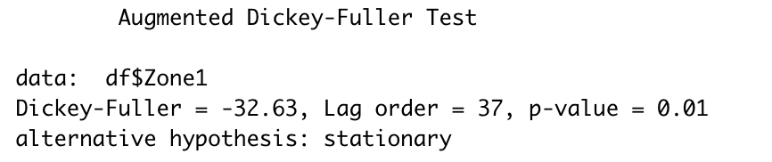
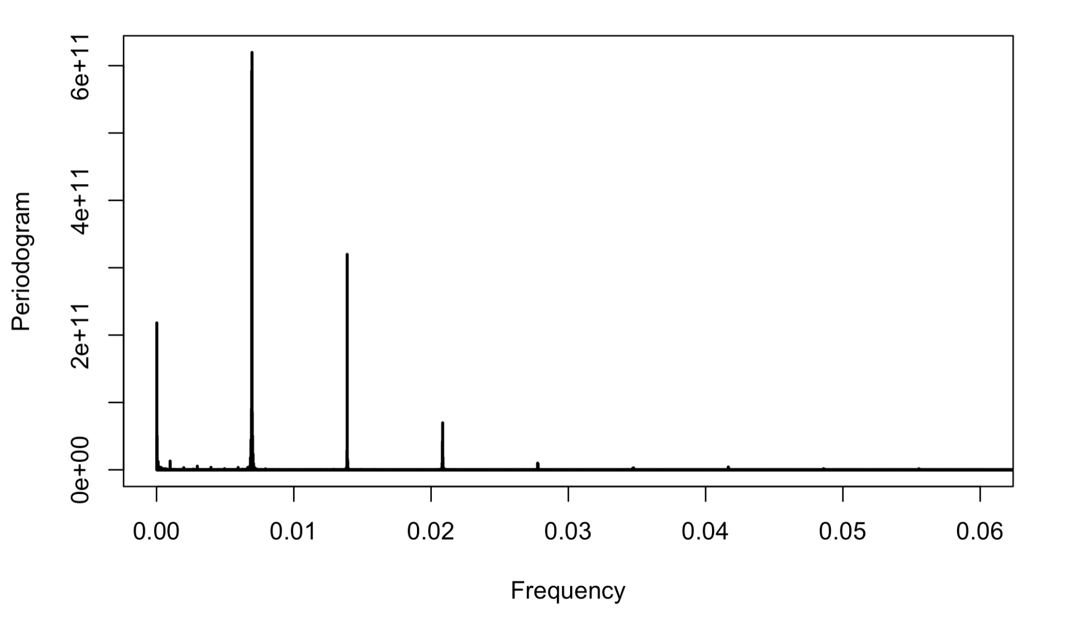
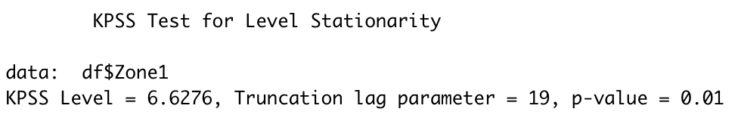
Tests
Seasonality Decomposition in Frequency Domain
Tests for stationarity
Augmented Dickey-Fuller (ADF) Test
Null hypothesis: non-stationary
P-value: 0.01, reject null hypothesis
Kwiatkowski-Phillips-Schmidt-Shin (KPSS) Test
Null hypothesis: stationary
P-value: 0.01, reject null hypothesis
Conclusion: The series is difference stationary.
Processing technique
Differencing
Decomposition in daily & weekly frequencies
Stationarity
Does not imply seasonality at this level
Daily
Every 12 Hours
Every 8 Hours

Slide 13
Feature Engineering & Selection
Initial Features
Feature Engineering
Feature Selection
Based on correlation wrt Power Consumption
Temperature
Humidity
Wind Speed
Diffuse Flows
Hour
Minute
Day of the week
Temperature
Hour
Day of the week

Slide 14
04
Forecasting Models

Slide 15
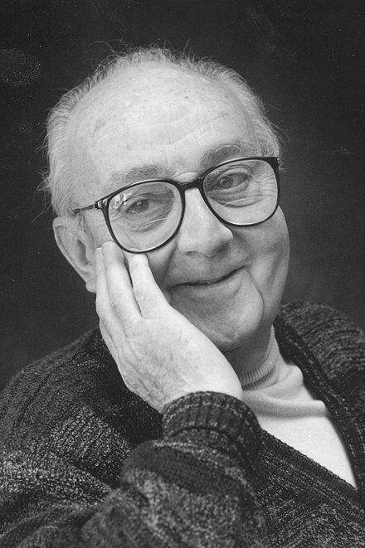
— George Box
“All models are wrong, some models are useful.”

Slide 16
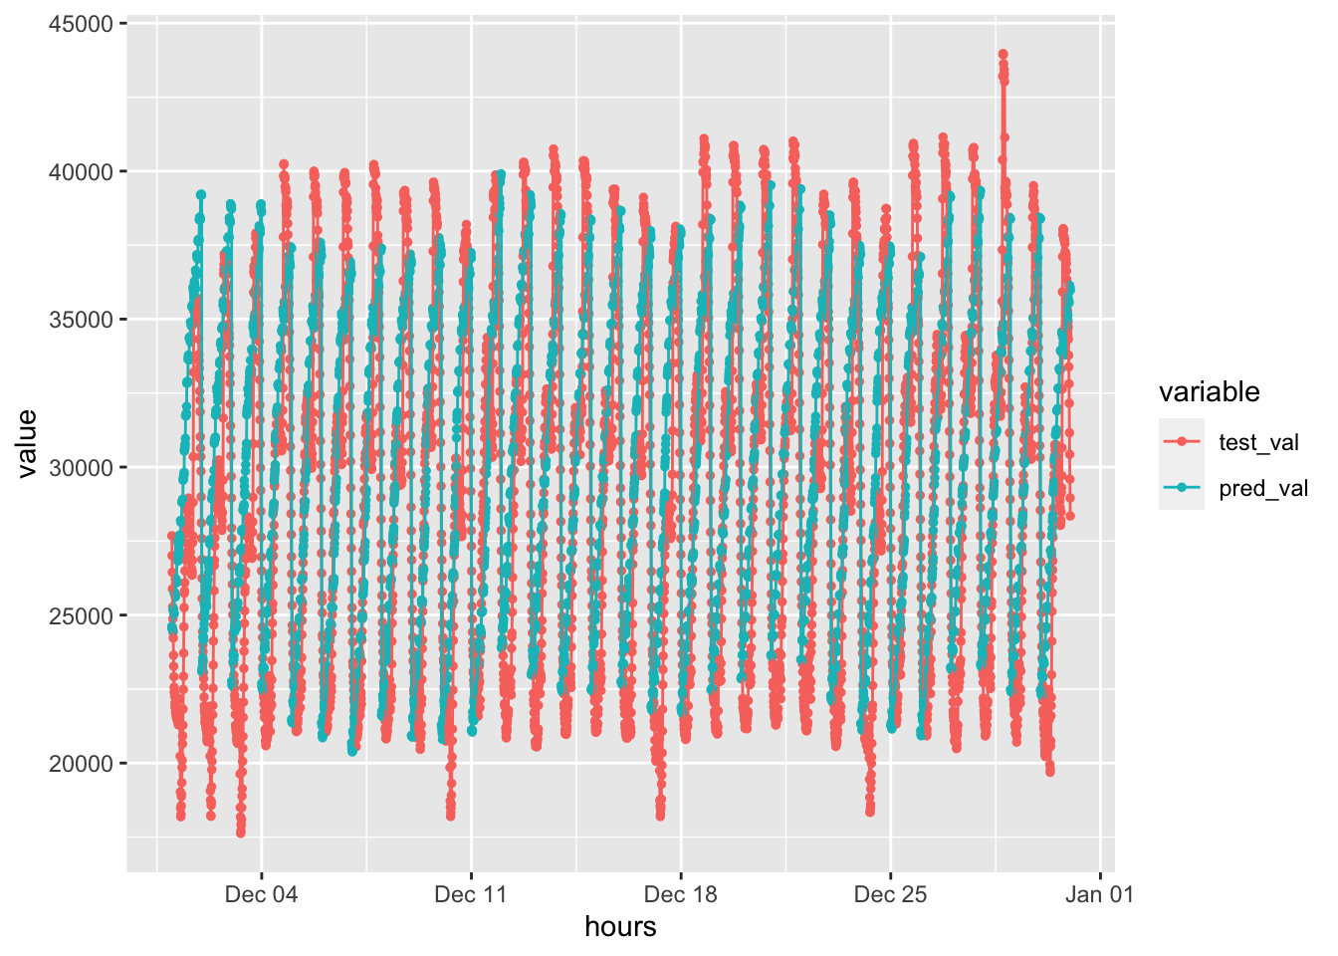
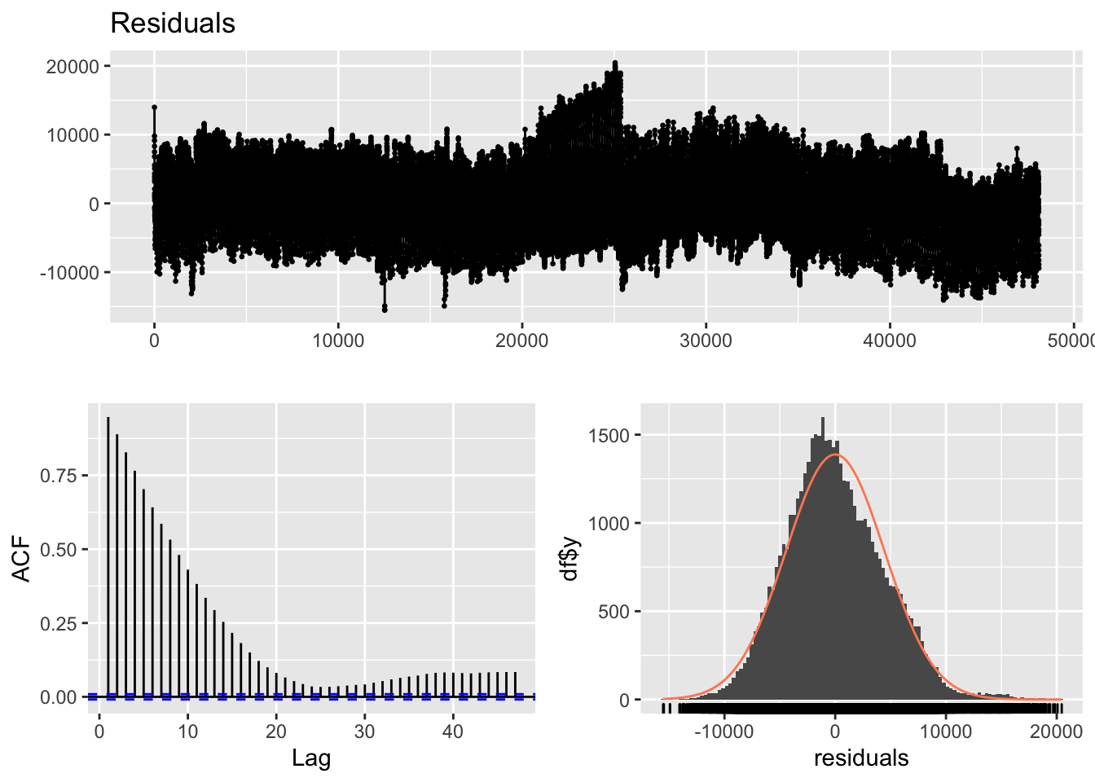
Baseline Model: Linear Regression
Model selection: Temperature | Temperature + hour | Temperature + hour + dayOfWeek
Best Performing: Temperature + hour
sMAPE: 0.2028148
Training time: 27.51 secs
Residuals are slightly right skewed
ACF: Slow decay, spikes at lag 1…
Notes:
A positive correlation indicates that large current values correspond with large values at the specified lag; a negative correlation indicates that large current values correspond with small values at the specified lag.
The absolute value of a correlation is a measure of the strength of the association, with larger absolute values indicating stronger relationships.

Slide 17
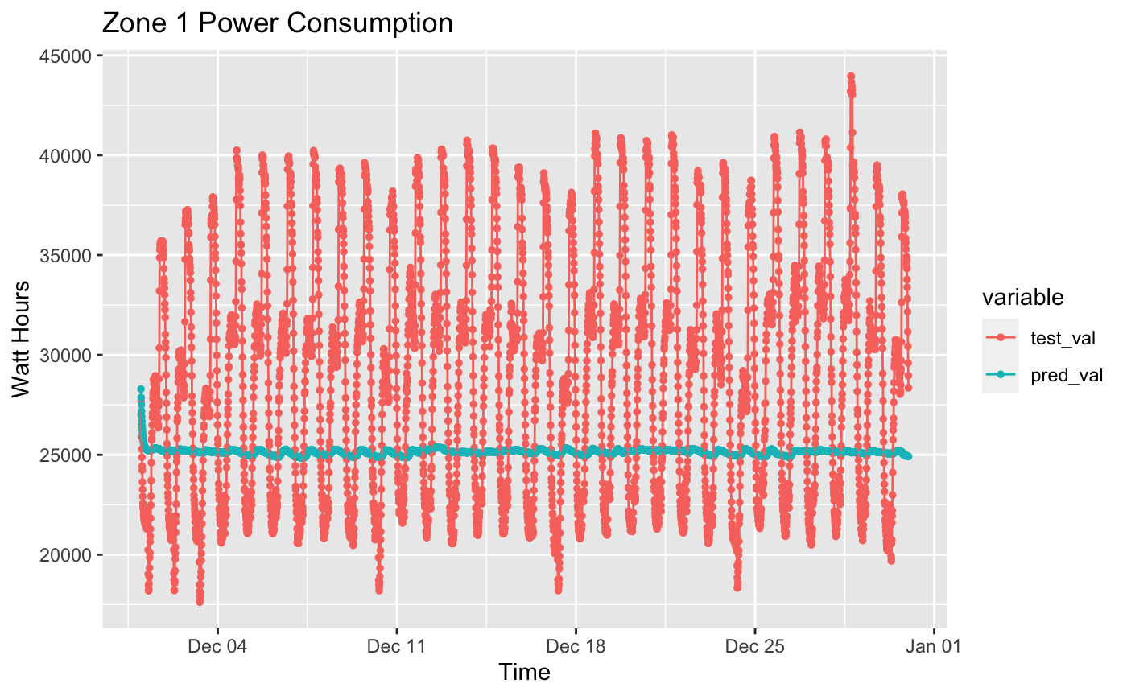
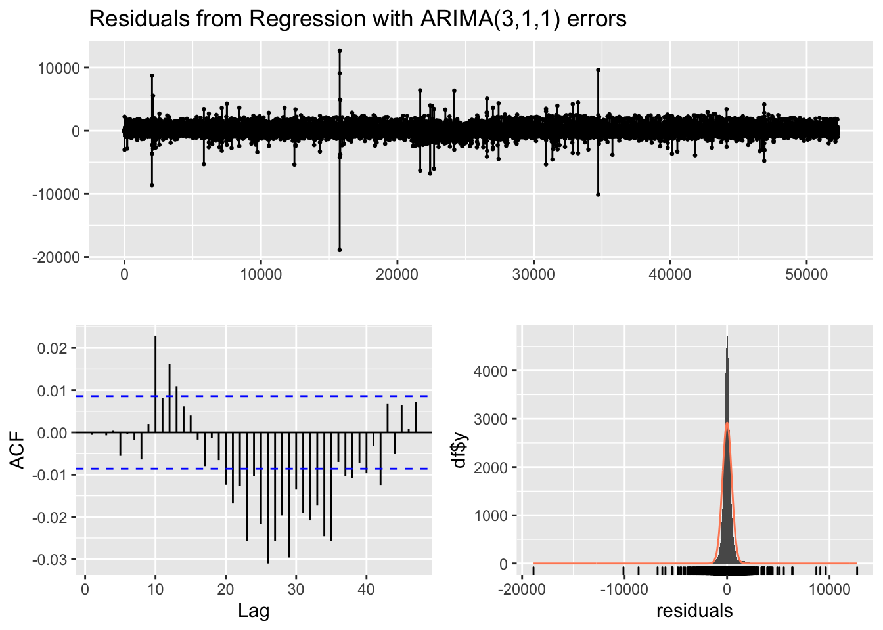
Baseline Model: Regression with ARIMA errors
Model selection: Temperature | Temperature + hour | Temperature + hour + dayOfWeek
Best Performing: Temperature
sMAPE: 0.2082446
Training time: 30.76 secs
Residuals are close to normal distribution with a smaller standard deviation
ACF: Slow decay, spikes at lag 10, 26…

Slide 18
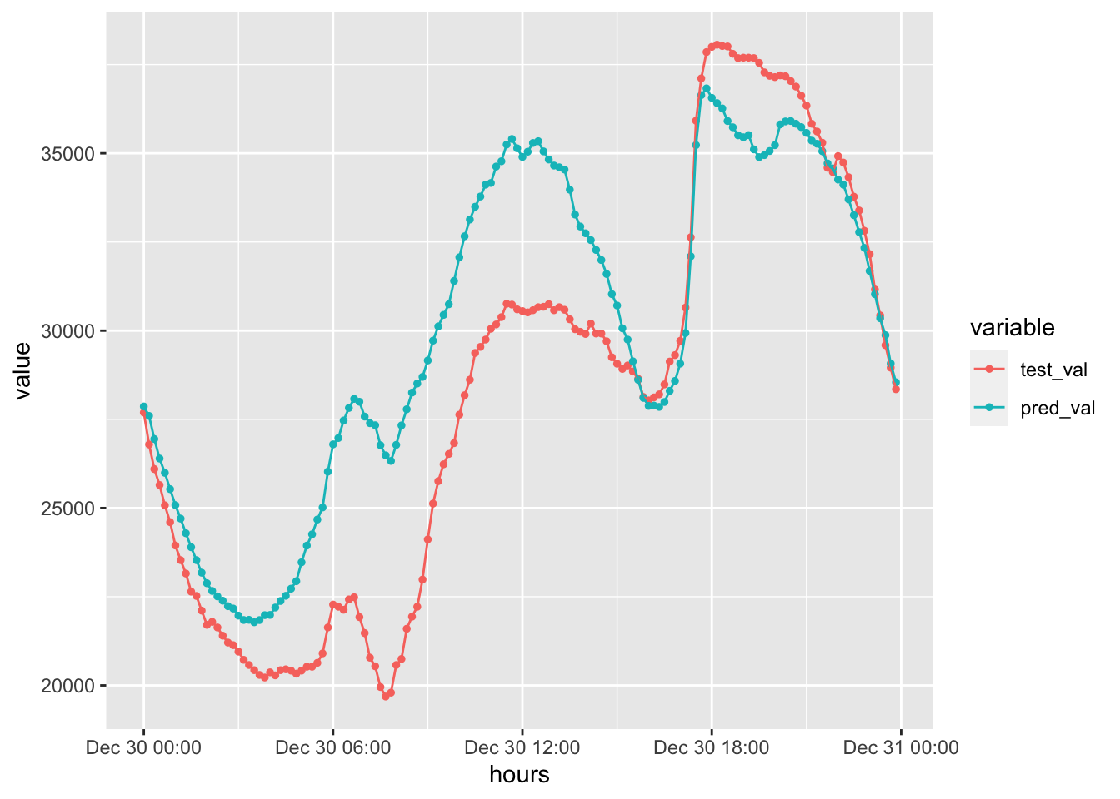
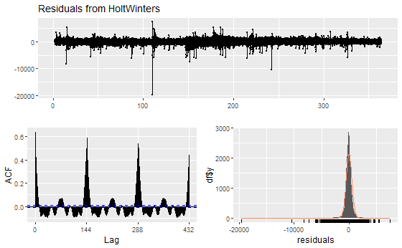
Holt Winters with Exponential Smoothing
Best Performing: Daily Frequency
sMAPE: 0.09130168
Training time: 3.44 secs
Residuals are close to normal distribution with a smaller standard deviation
ACF: Slow decay, spikes at lag 0, 144,288…
Daily Frequency | Weekly Frequency

Slide 19
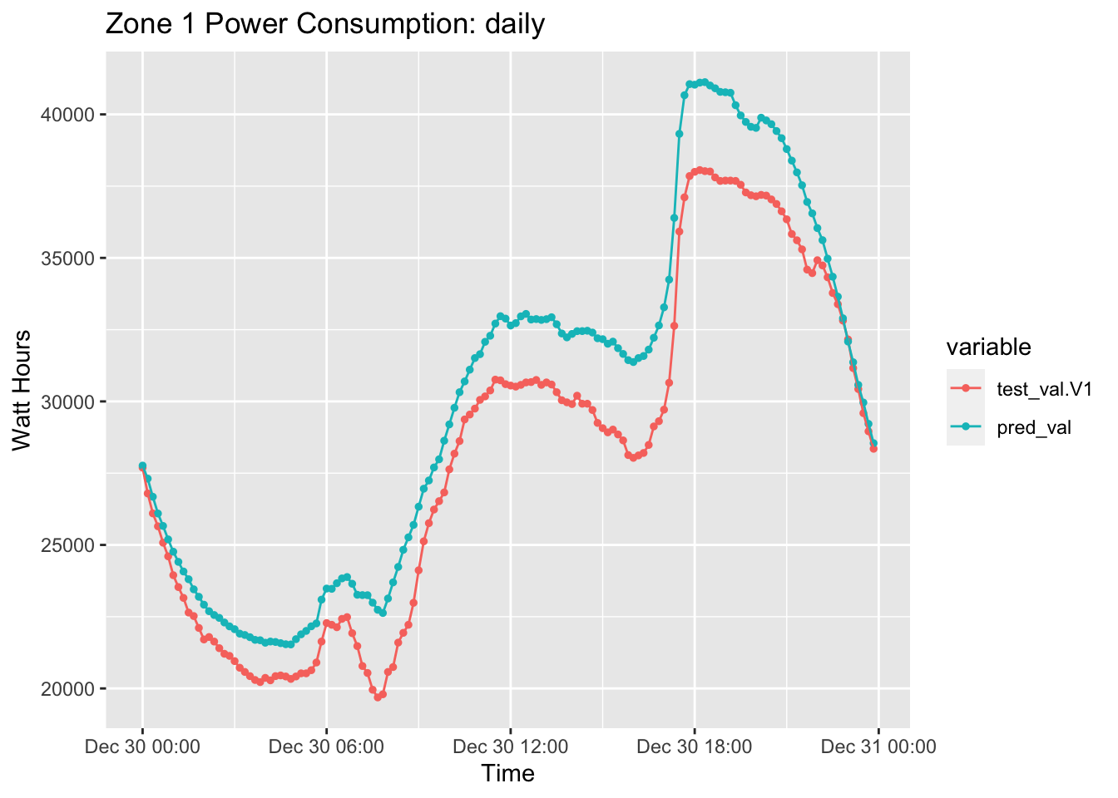
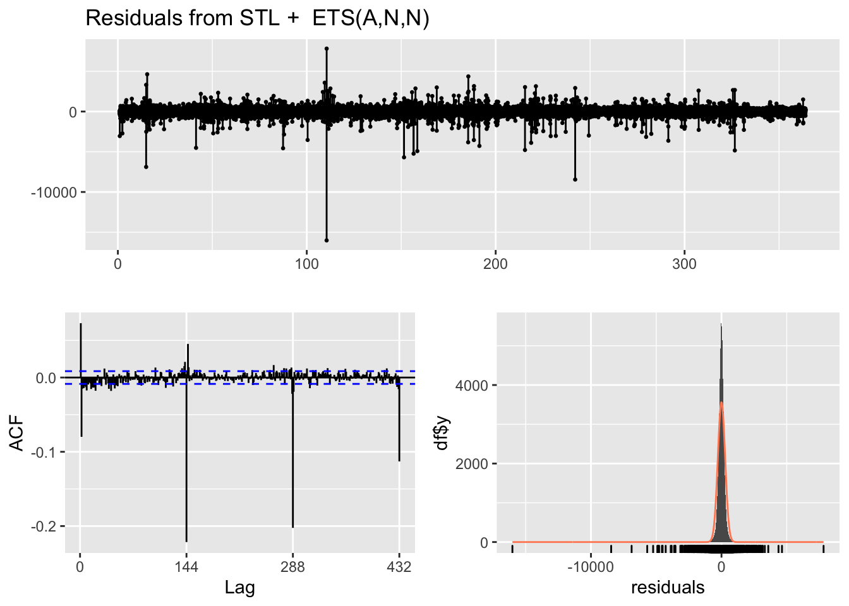
STLF
Best Performing: Daily Frequency
sMAPE: 0.06732304
Training time: 3.53 secs
Residuals are close to normal distribution with a smaller standard deviation
ACF: spikes at lag 0, 144, 288,432…
Seasonal and Trend decomposition using Loess Forecasting model
Daily Frequency | Weekly Frequency
Notes:
STLF model can be defined as Seasonal and Trend decomposition using Loess Forecasting model.

Slide 20
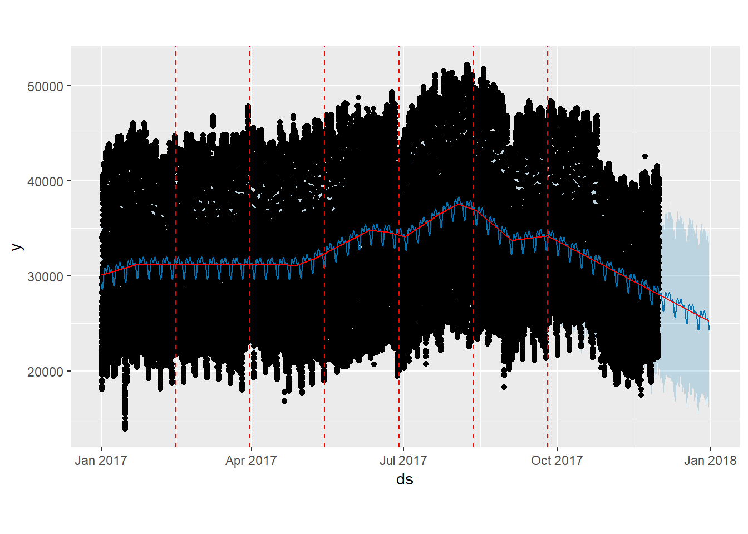
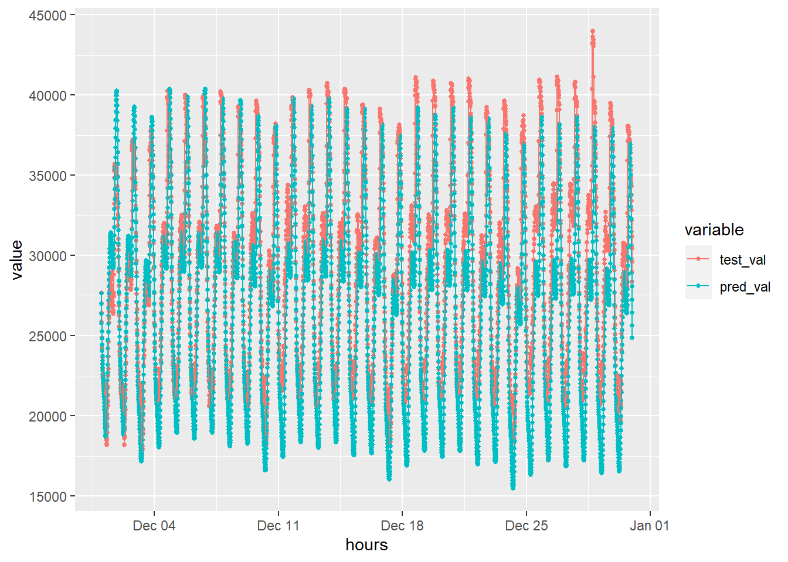
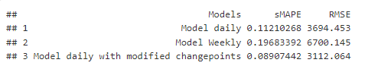
Prophet
Best Performing: Daily Frequency / Change Points
sMAPE: 0.089074
Training time: 36.04 secs
Daily Frequency | Weekly Frequency | Daily Frequency with modified number of change points

Slide 21
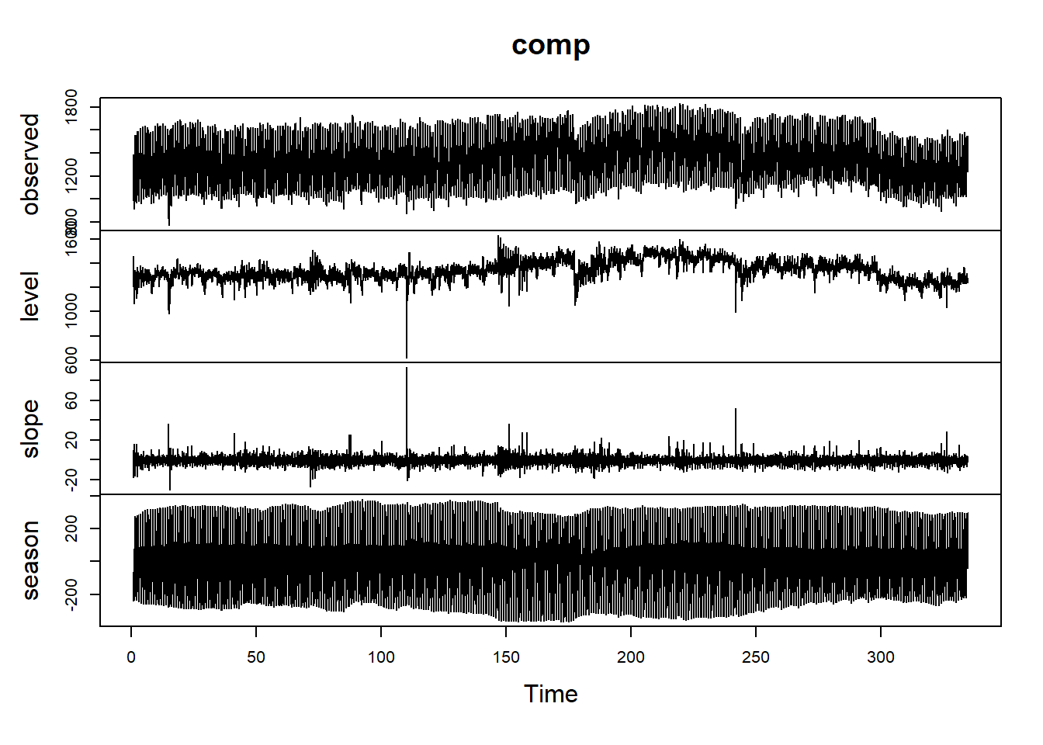
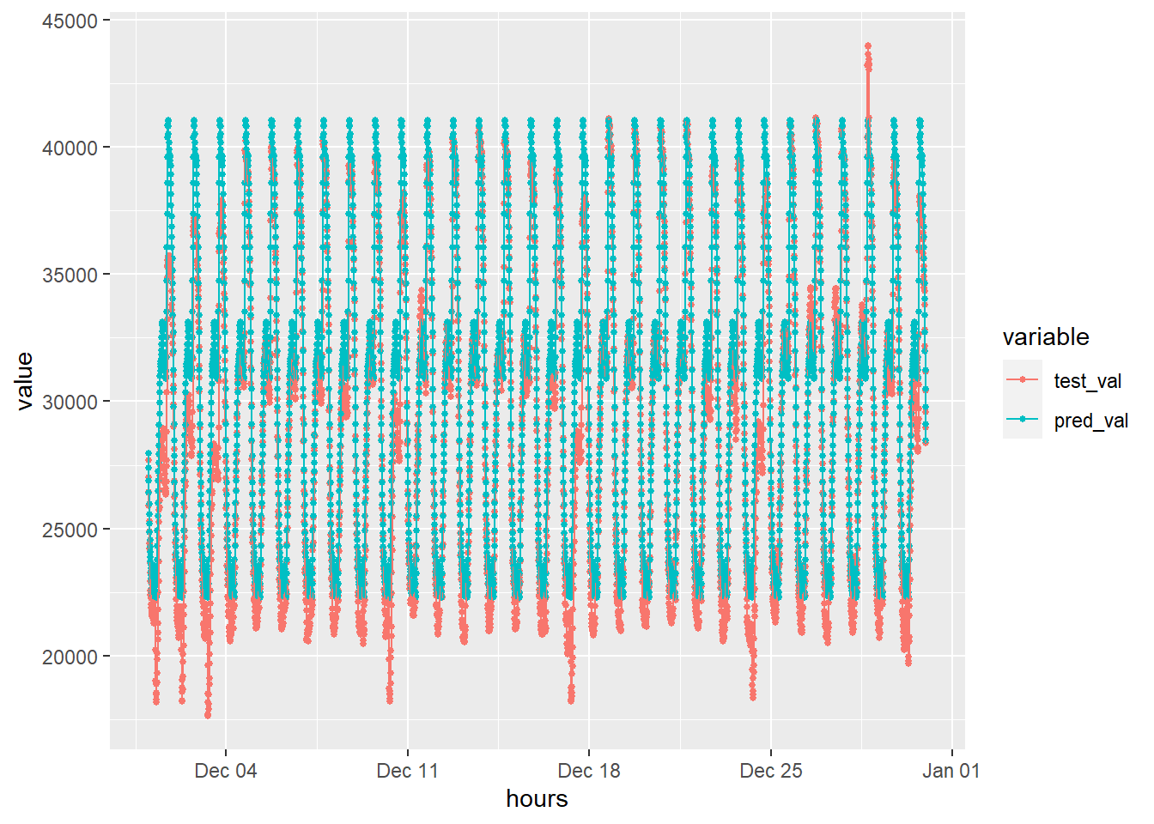
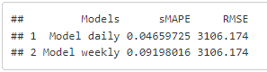
Tbats
Best Performing: Daily Frequency / Change Points
sMAPE: 0.0465972
Training time: 421.14 secs
Daily Frequency | Weekly Frequency

Slide 22
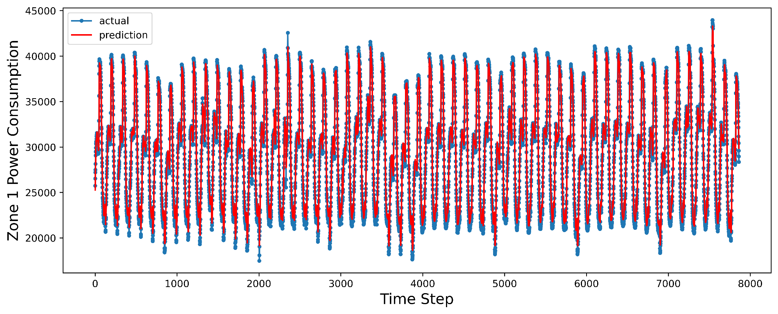
LSTM
Use MinMaxScaler()
Test-train split
(lag=3/12/24 , test_ratio=0.15)
Implement LSTM model
Invert the transformation
Best Performing: Lag = 3
sMAPE: 0.02402
Training time: 22.88 secs
 | RMSE | sMAPE
Lag = 3 | 979.0666 | 0.02402
Lag = 12 | 1595.1529 | 0.03810
Lag = 24 | 1490.0596 | 0.03416

Slide 23
05
Model Evaluation

Slide 24
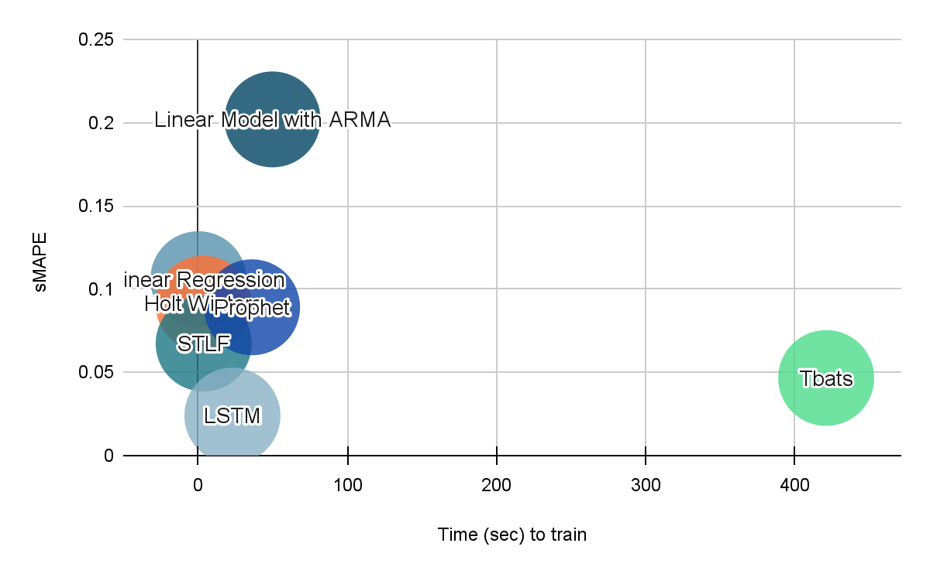
Model Comparison
 | sMAPE | Time(sec)
Linear Regression | 0.1060 | 0.04
Linear Model with ARIMA | 0.2080 | 30.76
Holt Winters | 0.0913 | 3.44
STLF | 0.0673 | 3.53
Prophet | 0.0891 | 36.04
Tbats | 0.0466 | 421.14
LSTM | 0.024 | 22.88

Slide 25
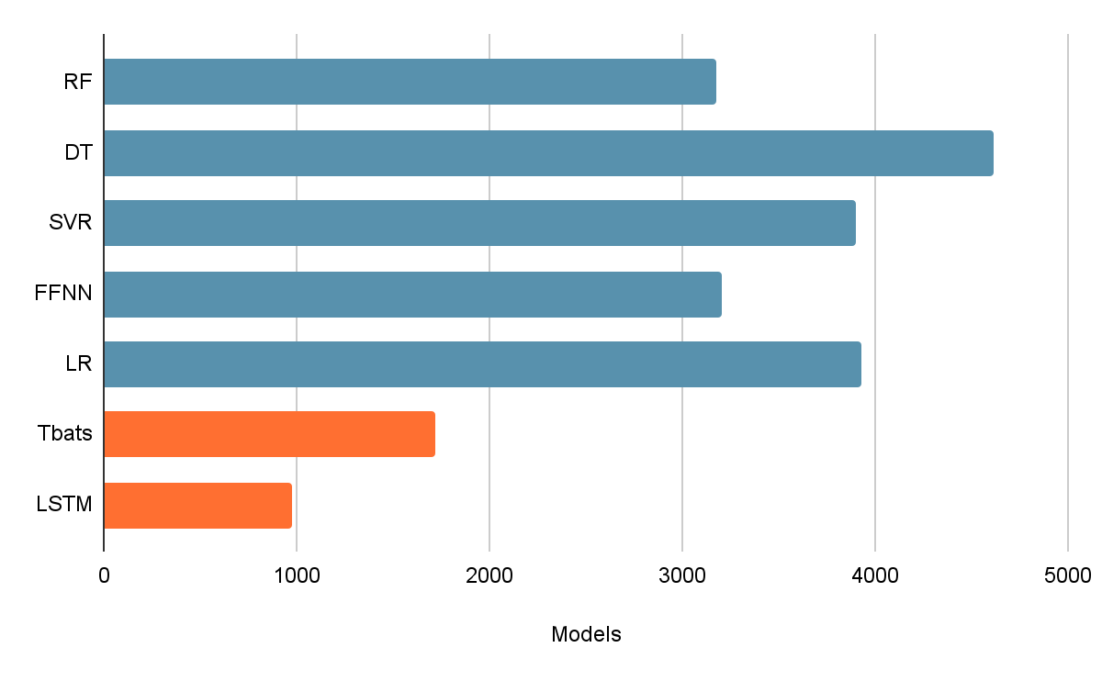
Forecasting vs supervised learning models
 | RMSE
RF* | 3174.7
DT* | 4613.9
SVR* | 3898.7
FFNN* | 3203.6
LR* | 3925.5
Tbats | 1722.6
LSTM | 979.1
*source: https://ieeexplore.ieee.org/document/8703007

Slide 26
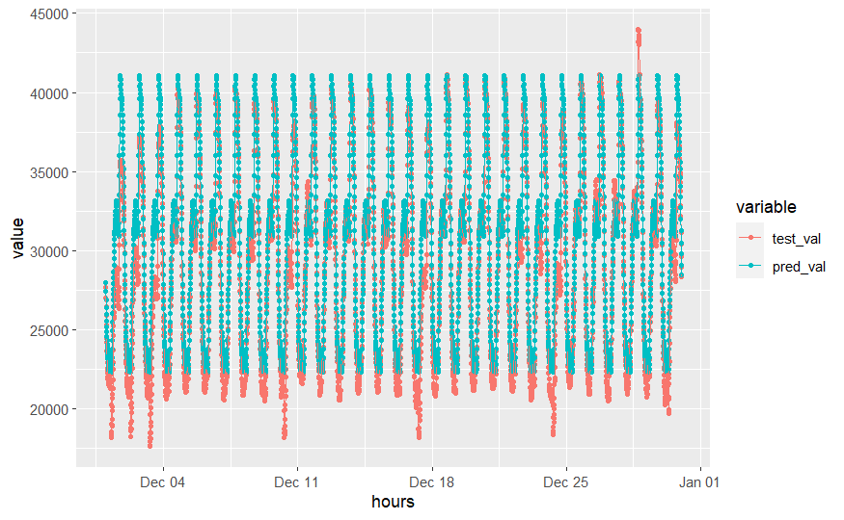
Model Forecasts
Actual vs predicted electricity power consumption of comparative models every 10 minutes
TBATS Model
LSTM Model

Slide 27
06
Potential Improvements

Slide 28
Potential next steps and improvements
Apply the same study to different power grids
Financial study to measure the economic impact to configure power supply based on forecasts.
Real time model performance and improvement

Slide 29
References
https://archive.ics.uci.edu/ml/datasets/Power+consumption+of+Tetouan+city
https://ieeexplore.ieee.org/document/8703007
Prophet | Forecasting at scale. (facebook.github.io)
Time Series Forecasting using TBATS Model | by Nadeem | Analytics Vidhya | Medium
Link to our Github repository:
https://github.com/martincopello/power_consumption_time_series

Slide 30
Thank you!
Q & A

Slide 31
Appendix

Slide 32
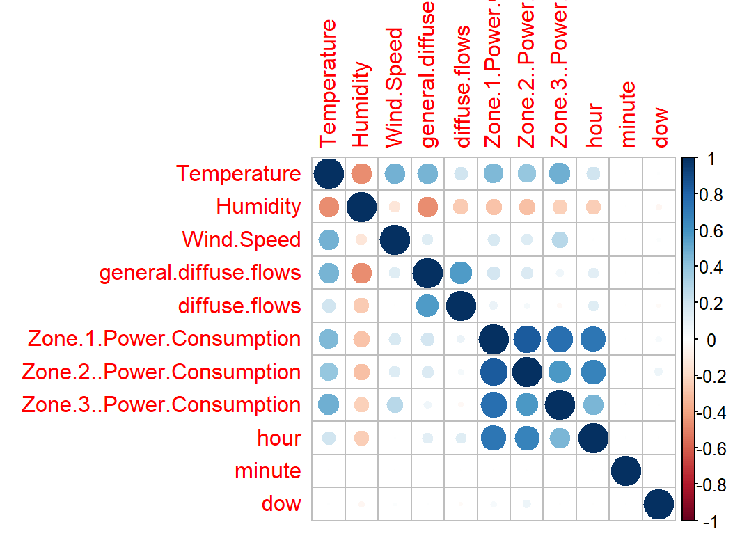
Correlation Plot with added features

